Slide 1
DATA 824 Product Development Project: What Affects Rates of Crime?
Nathan Brophy
Fall 2022
DATA 824: Data Acquisition and Visualization

Slide 2
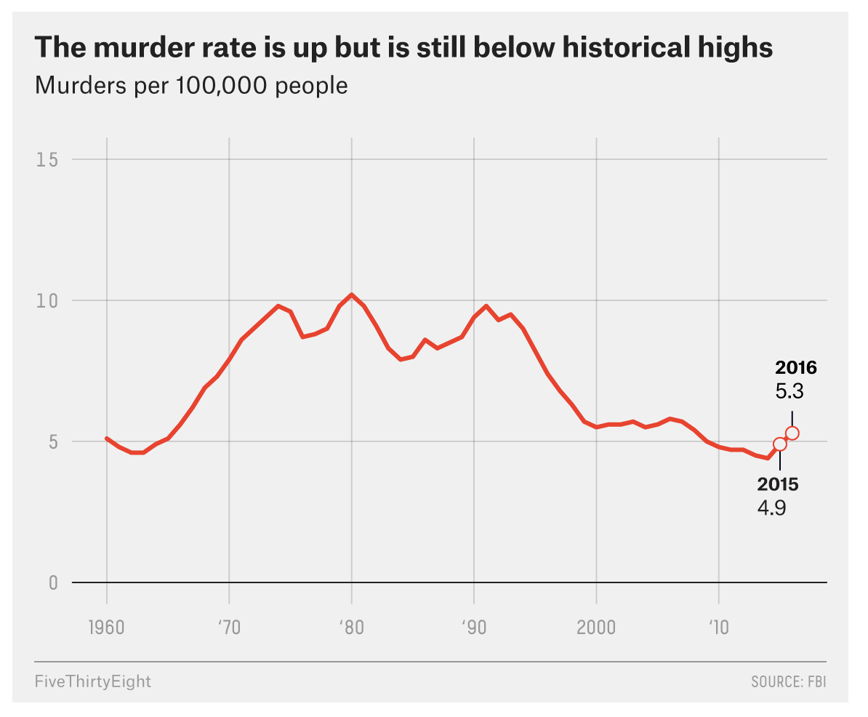

Slide 3
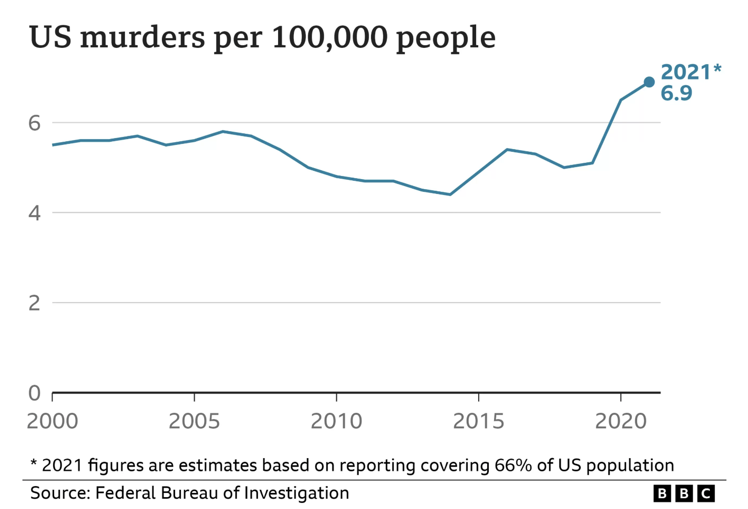

Slide 4
Research Question
What are the factors that affect crime rates?
This question is important for several reasons
(1) It has public policy implications (e.g., what laws should we pass to make it safer for everyone?)
(2) It also has normative implications (e.g., how much power should governments have?)
Why is it, based on slides 1 and 2, do we see increases in violent crimes periodically throughout the United States?
These two graphs show the initial motivation to conduct some analysis and visualization of crime rates.

Slide 5
Literature Review: What affects crime?
Past research shows there are many factors that contribute to crime (both in the US and elsewhere):
Relative poverty and income inequality (Patterson 1991; Fajnzylber et al. 2002)
Level of police (Becker 1969; Ehrlic 1972; Worrall and Kovandzic 2010)
Police spending (Atems 2020)
Youth unemployment (Ajaegbu 2012) –although the focus was on Nigeria
Family income and geographic concentration of poverty (Heller et al. 2011)

Slide 6
Some hypotheses:
Based on the brief literature review, we see there are several factors that could affect the crime rate leading to several testable hypotheses:
H₁: Police spending will decrease the aggregate crime rate
H₂: Higher family incomes should decrease the aggregate crime rate
H₃: Lower unemployment rates should decrease the crime rate
H₄: Lower income inequality should decrease the crime rate

Slide 7
The Data!
To test these hypotheses, I use a unique dataset on crime that collects information from 47 states In 1960 (at the beginning of the 60s-70s crime explosion) in the United States
Data come from Vandaele, W. (1978) Participation in illegitimate activities: Ehrlich revisited. In Deterrence and Incapacitation, eds A. Blumstein, J. but are rounded numbers
File can be downloaded from at: http://www.statsci.org/data/general/uscrime.html
Main response variable: Crime rate (number of offenses per 100,000 people)
Main explanatory variables: unemployment rate, police spending (in 1959 and 1960), household income, and probability of imprisonment (i.e., the ratio of number of commitments to number of offenses) among other variables.

Slide 8
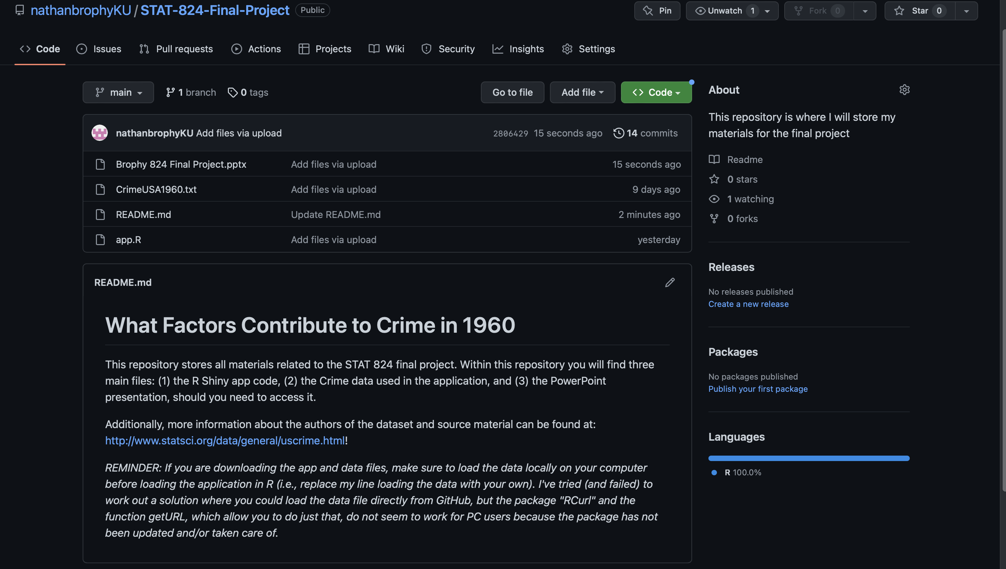
Let’s Explore the Data With an R Shiny Application
Where to access the material (GitHub): https://github.com/nathanbrophyKU/STAT-824-Final-Project (see picture below for visual information on repository name and README.txt files):

Slide 9
Shiny Application Information
For this project, I developed a shiny application designed to test and play around with simple linear regression models
This application allows users to pick and choose explanatory and response variables that produce a scatterplot with overlayed linear regression AND smoothing splines for direct comparison
That is, do relatively inflexible methods (linear regression) do better at capturing the data than more flexible methods (smoothing splines)?
Additional information:
You will also be able to see histogram-density plots (with overlayed blue-dashed mean line) and simple regression model information
You can also browse the Crime data in the final panel of the application

Slide 10
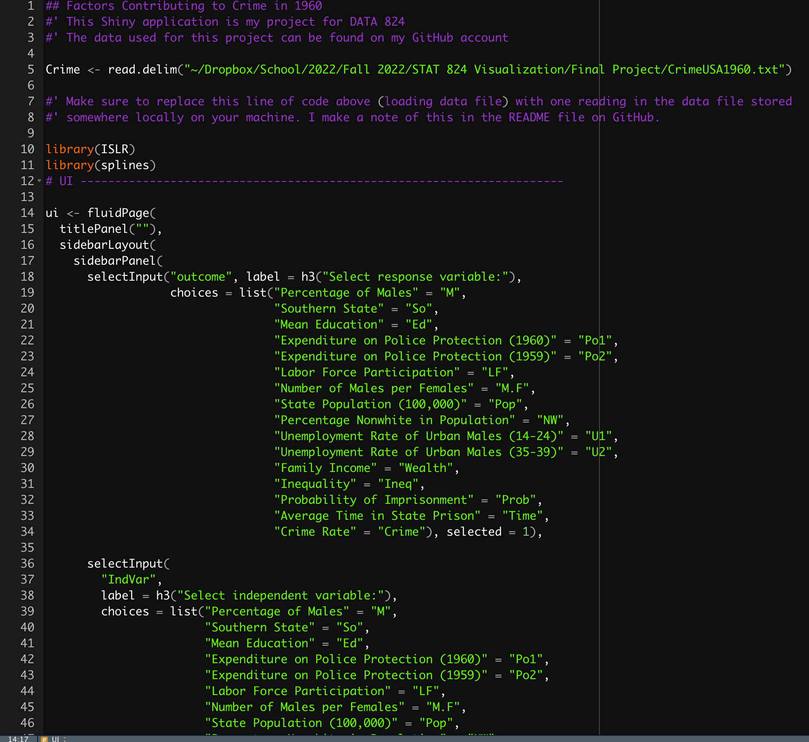
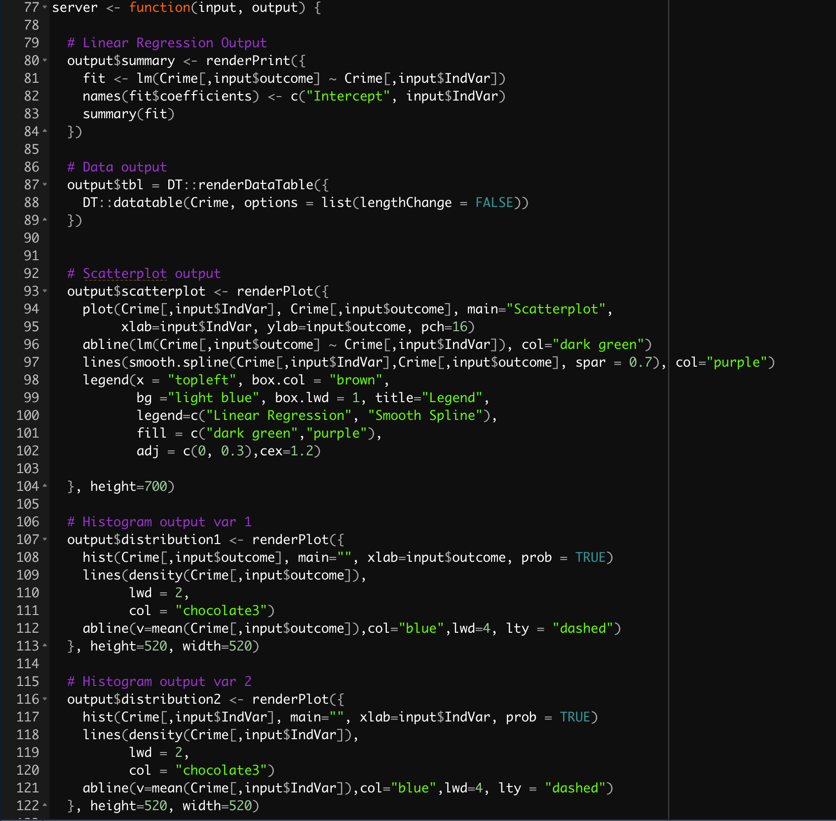
Let’s take a look at the .app file briefly...

Slide 11
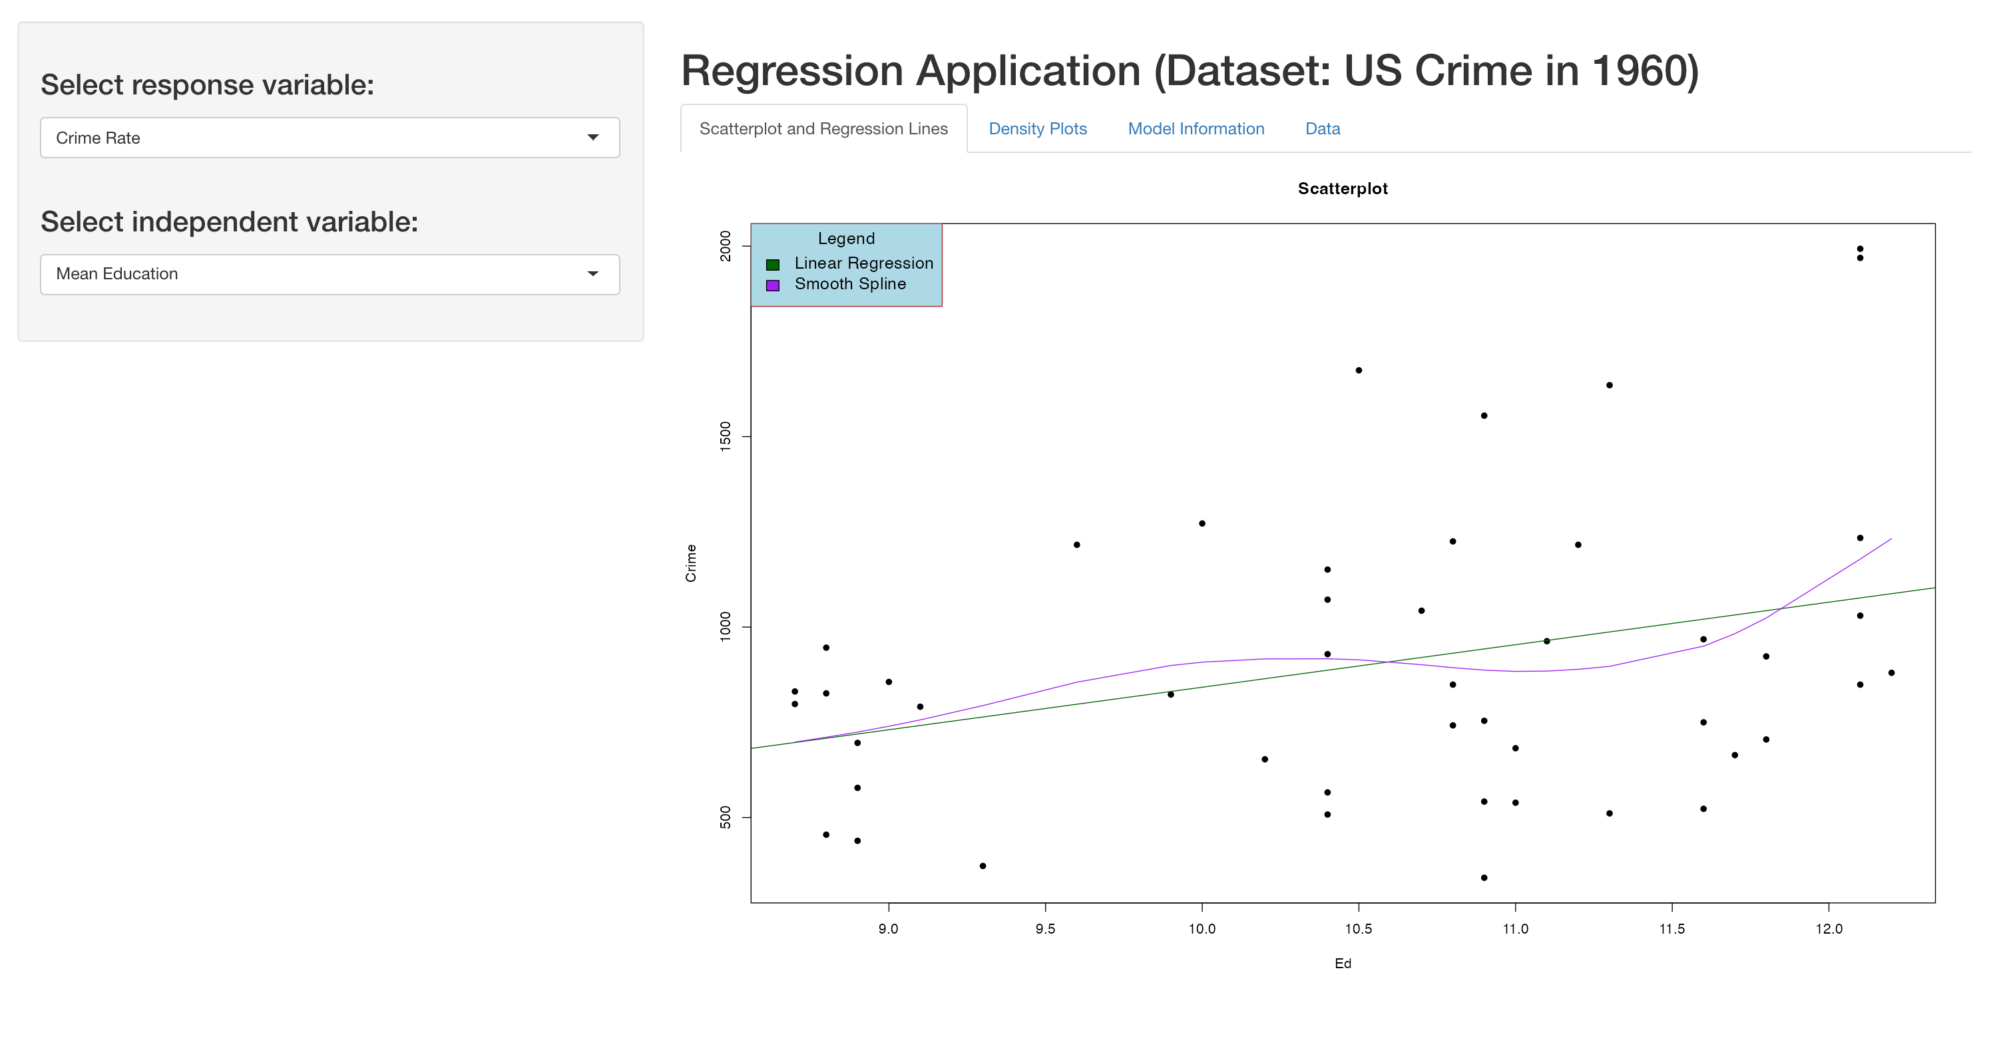
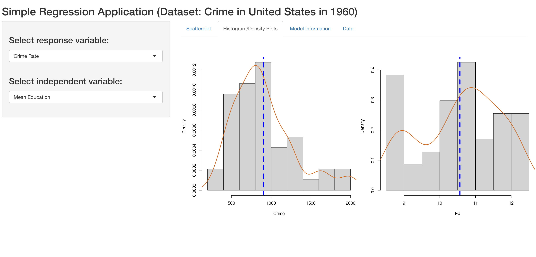
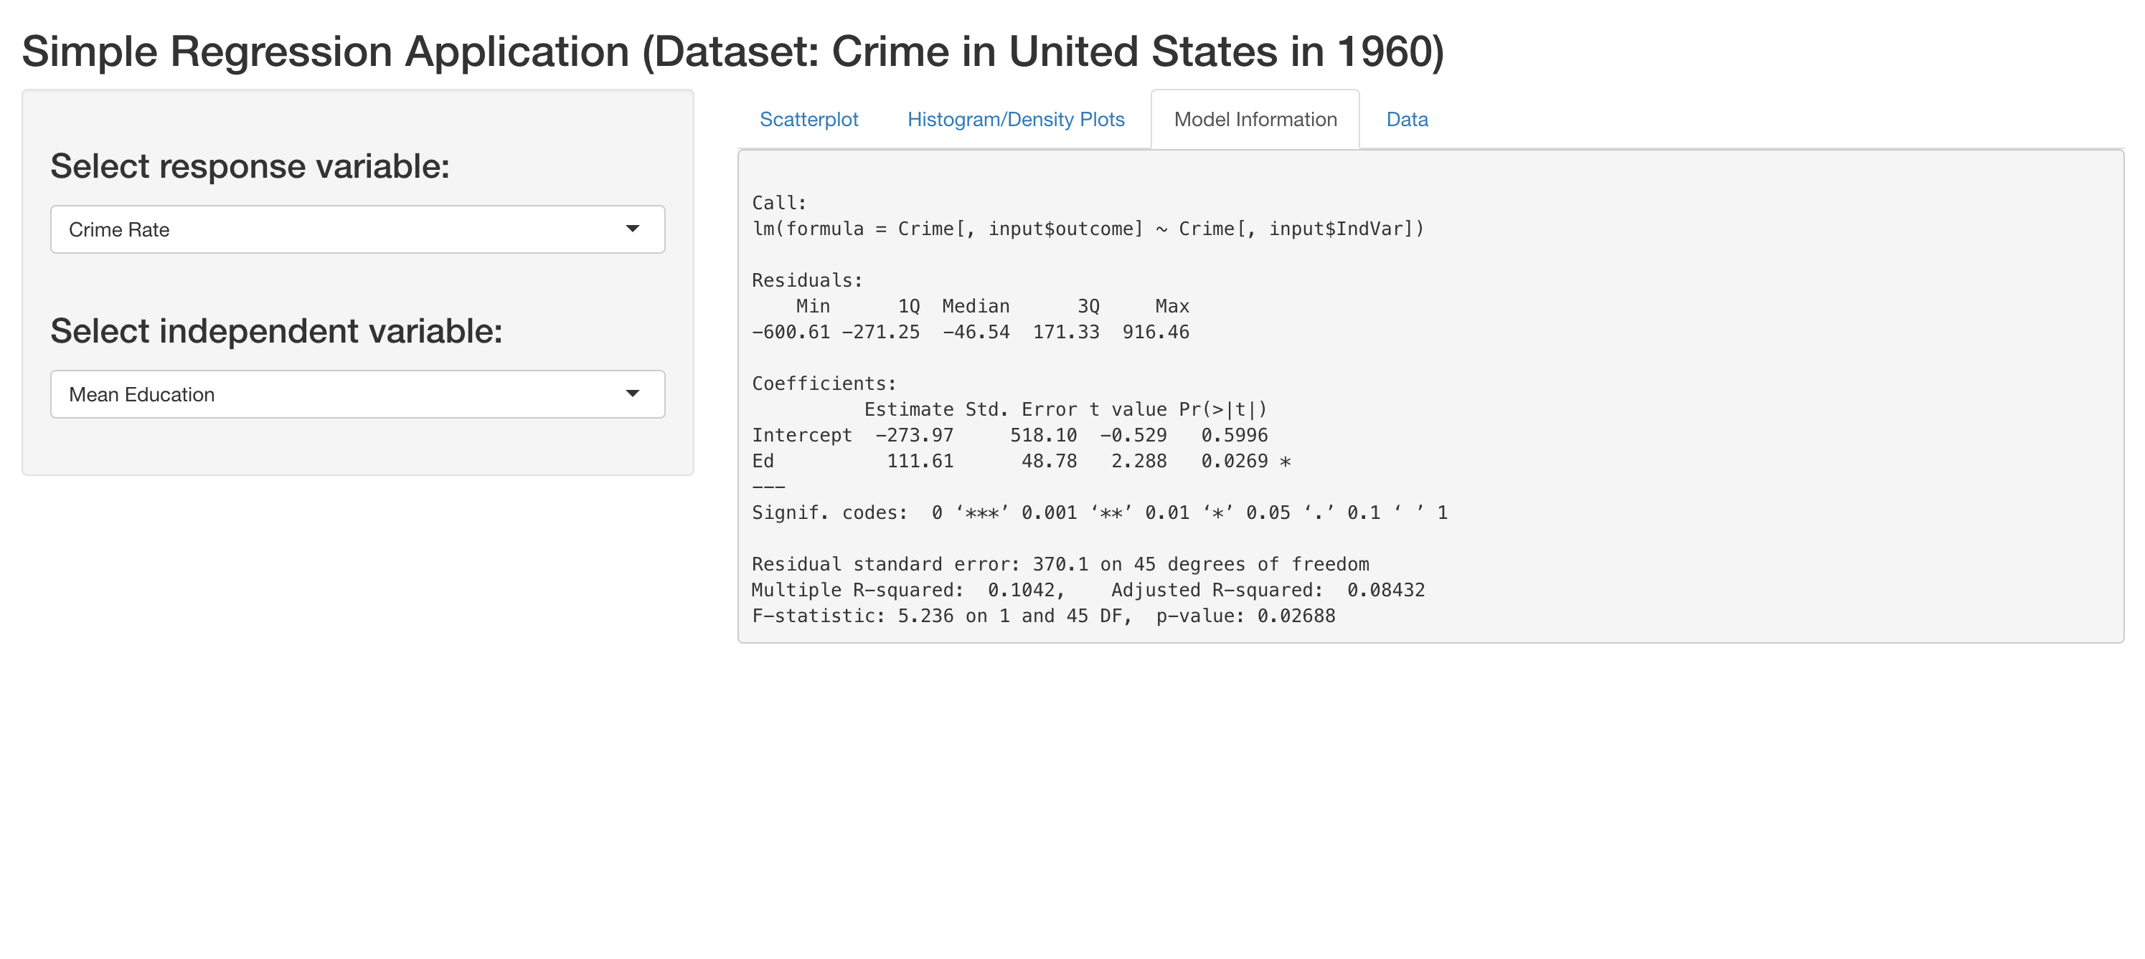
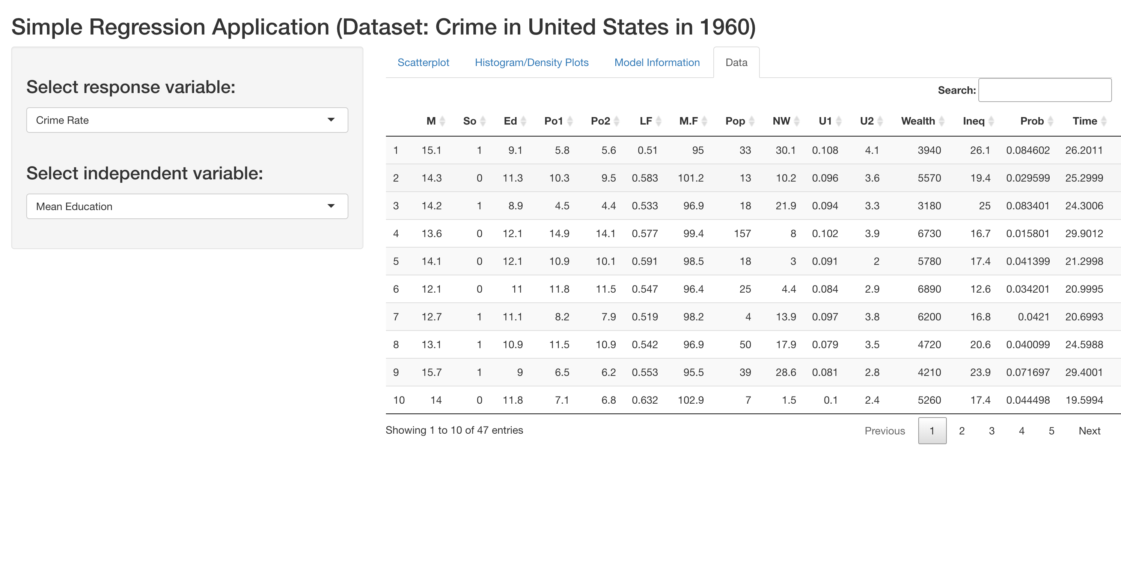
Now Let’s Take a Look at the Application UI! (Example: Mean Education)

Slide 12
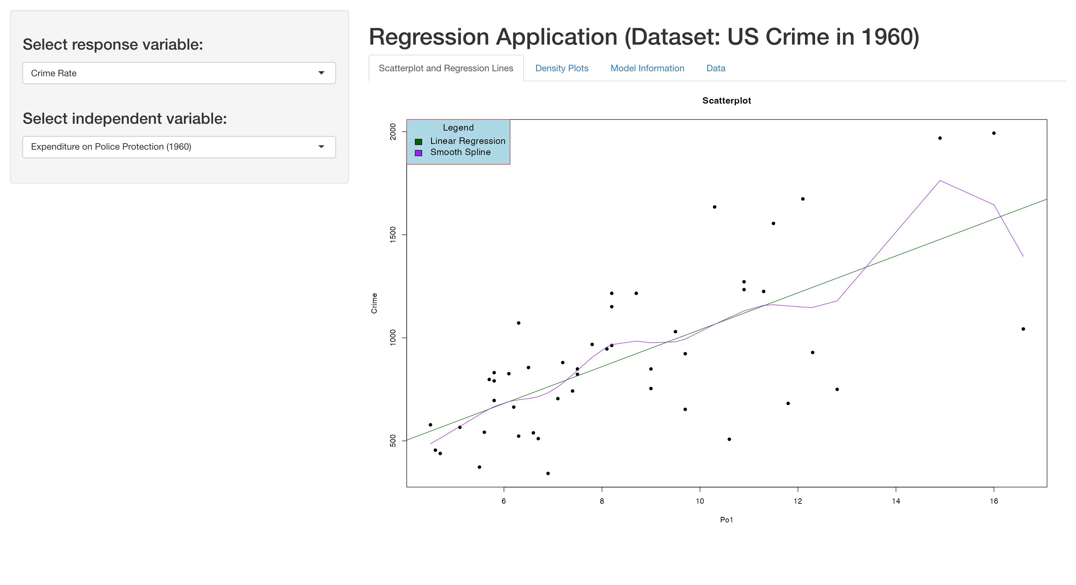
Testing Some of My Hypotheses (Police Spending):

Slide 13
Testing Some of My Hypotheses (Police Spending) Cont.
Interesting, previous research suggests that spending on police should lead to decreased crime rate, but based on these analyses, we see that the relationship is actually reversed (again, we should be careful about using too causal language here)
This pattern seems unlikely—I’ll return to it in the conclusion.

Slide 14
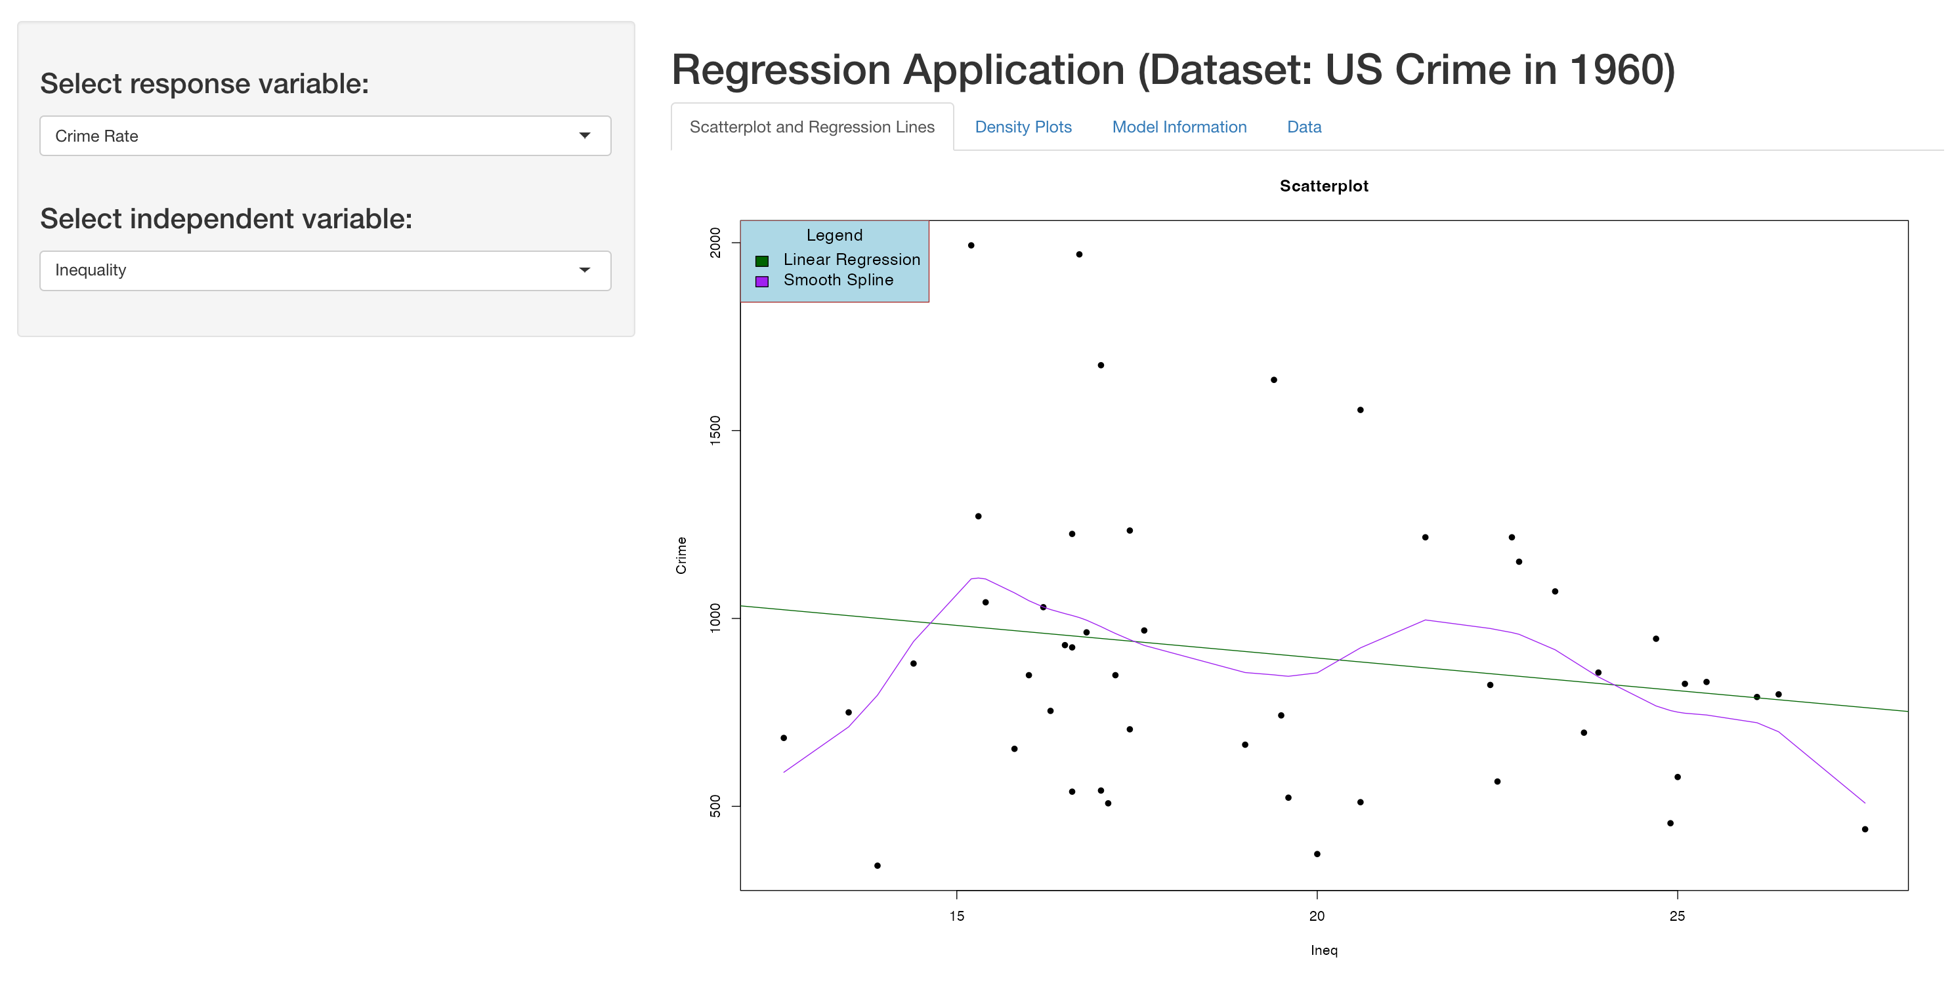
Testing Some of My Hypotheses (Inequality):

Slide 15
Testing Some of My Hypotheses (Inequality) Cont.
This one is also curious. Inequality in the dataset is operationalized as the percentage of families living below the poverty line. However, as the scatterplots shows, this relationship between crime and poverty may not exist or is even reversed.
Again, I’ll return to this in the conclusion.

Slide 16
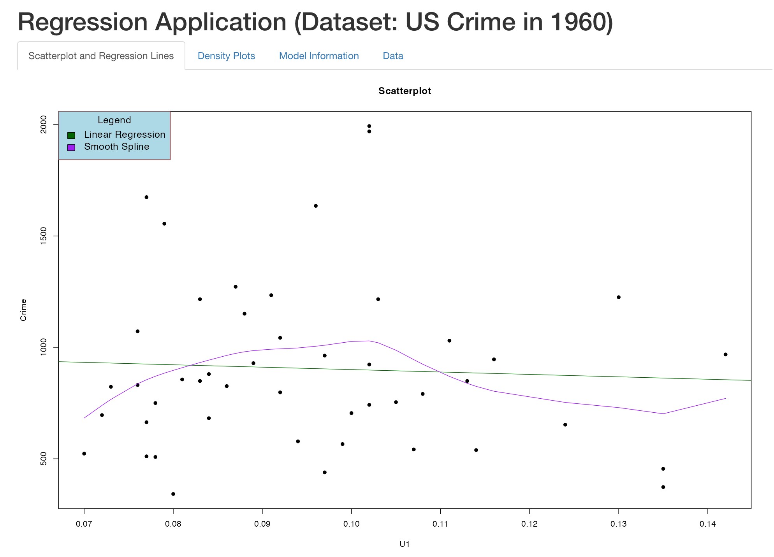
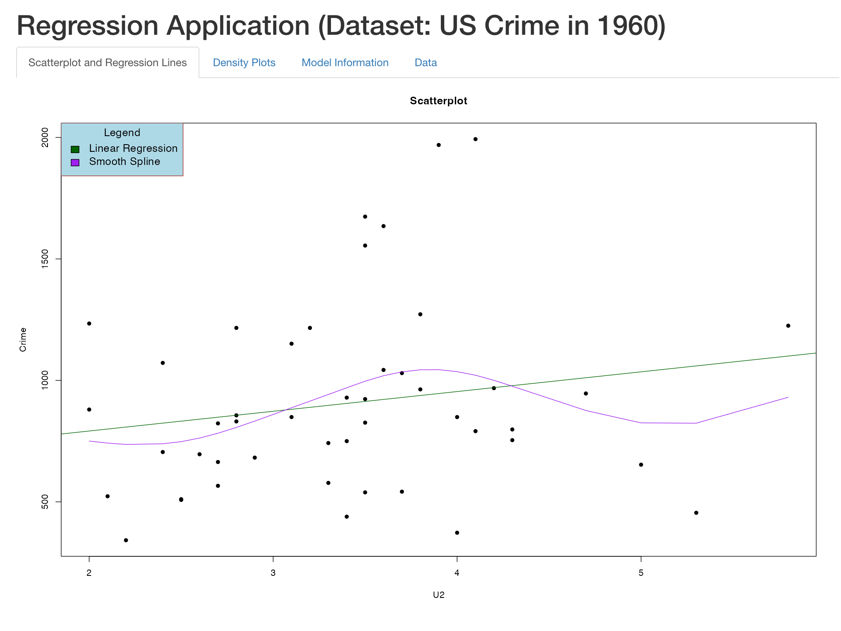
Testing Some of My Hypotheses (Unemployment):

Slide 17
Testing Some of My Hypotheses (Unemployment) Cont.
There is some evidence to suggest that increasing unemployment correlates with increasing crime rates—especially for males 35-39 (right panel of previous slide) in the 47 states for which there are data
Relationship is less clear on males between 14-24 (left panel on previous slide)

Slide 18
Shortcomings
It seems quite unlikely that increased spending on police is associated with an increase in crime rates.
Similarly, increasing income inequality is related to increased crime—this also doesn’t seem right
Problems with this analysis:
(1) Looking at just 1960 in the US.
(2) limited data
(3) limited geographic area (maybe expand to look at crime in other countries)?

Slide 19
Conclusions
Overall, I wanted to provide and build an interactive application that allows users to pick/choose variables
You can explore relationships between variables that I have not considered for this project!
For example, instead of crime as the main response variable, try unemployment!
I also wanted to provide some different visualizations (e.g., histograms with more detailed information and a comparison of two different regression lines to visualize the relationship between selected variables)
While there is some evidence to support some of my hypotheses, there isn’t enough data to make a firm correlative statement
Thanks for looking at my project! I hope you had some fun playing around with some of the options!

Slide 20
GitHub Information: If You Missed It...
If you missed where to find my GitHub information in my presentation, you can find it again here: https://github.com/nathanbrophyKU/STAT-824-Final-Project

